Slide 1
“AI-Based Real-Time Flood Monitoring”
CSE7101- Capstone Project
Review-1
Batch Number: CAI_3
Under the Supervision of,
Dr.Mohammadi Akheela Khanum
Professor
School of Computer Science and Engineering
Presidency University
20231CAI3009 | VANDAN GOWDA R
20221CAI0118 | VAISHNAVI SALUNKE
20221CAI0112 | ANUSHA H G
Roll Number | Student Name
Name of the Program: B.Tech Computer Science & Engineering(Artificial Intelligence & Machine Learning)
Name of the HoD: Dr.Zafar Ali Khan N
Name of the Program Project Coordinator: Ms. Suma N G
Name of the School Project Coordinators: Dr. Sampath A K , Dr. Geetha A

Slide 2
Problem Statement Number:
Organization:
Presidency university
Category(Software):
Software (AI, ML, Web Technology)
Problem Description:
This problem statement focuses on applying artificial intelligence or machine learning algorithms to automate tasks, enhance decision-making, and provide predictive analytics in fields such as public services, agriculture, health, or utilities.
There is a need for an ML-based system that integrates meteorological and hydrological data with machine learning models to provide real-time flood forecasting, early warning, and decision support for effective disaster management.

Slide 3
Content
Problem Statement
Objectives
Background and Related work for title Selection
Analysis of Problem Statement
Innovation or Novel Contributions
Git-hub Link
Timeline of the Project
References

Slide 4
Objectives
To collect and integrate flood-related data (meteorological, hydrological, geospatial, and crowd-sourced) from multiple sources such as TMD Big Data and GLOFAS.
To develop and train AI/ML models for accurate real-time prediction of precipitation, water levels, and potential flood-based areas.
To design a responsive and user-friendly web platform that provides real-time flood alerts and visualizations (heatmaps, graphs, dashboards) accessible on both desktop and mobile devices.
To support disaster management authorities by enabling early evacuation planning, efficient rescue operations, and timely relief for flood victims.

Slide 5
Background and Related work for title Selection
Flood disasters cause massive damage to life, property, and infrastructure, while traditional monitoring systems based on rainfall gauges and manual data lack real-time accuracy and automation.
AI and Machine Learning techniques have emerged as powerful tools to analyze meteorological, hydrological, geospatial, and crowd-sourced data for improved flood prediction.
Prior research (Puttinaovarat & Horkaew, Chang & Chang, Tayfur & Singh, Choi & Kim) shows that ML models like Decision Trees, Random Forests, ANN, and SVM enhance forecasting accuracy but still lack user-friendly, real-time, web-based integration.
The title “AI-Based Real-Time Flood Monitoring” reflects the project’s goal of combining big data, ML models, and responsive web technology to deliver an automated, accurate, and accessible flood alert system.

Slide 6
Analysis of Problem Statement
Flood disasters cause loss of life, property damage, and infrastructure disruption, and existing systems often fail to provide timely and reliable flood forecasts.
Current flood forecasting tools are manual, data-intensive, and not suitable for real-time early warning, making evacuation and rescue missions less effective.
There is a critical need for a responsive web-based system that supports automation, availability, and usability for both authorities and the public.
A novel system can be developed by fusing meteorological, hydrological, geospatial, and crowd-sourced data with machine learning models to forecast precipitation and predict flood-prone areas in real time.

Slide 7
Technology Stack Components:
Data Sources
  TMD Big Data → Hourly precipitation and rainfall prediction.
  GLOFAS (Global Flood Awareness System) → Hydrological and water flow data.
  Geospatial Data → Location-specific flood risk information.
  Crowd-Sourced Data → Real-time inputs from affected communities.
Machine Learning Models
  Decision Tree, Random Forest, ANN and SVM for evaluating and predicting flood situations.
  Forecasting precipitation, water levels, and flood-prone zones.
Backend Technologies
  Python 3.10.4 for AI/ML development.
  APIs for real-time data integration (e.g., weather.visualcrossing.com).
  Flask
Frontend Technologies
  Web Technology → HTML5, CSS3, JavaScript, Bootstrap.
  Visualization Tools → Interactive heatmaps, flood predictions, and dashboards.
Deployment
  Cloud Hosting (AWS/Azure/GCP) for distributed, real-time access.
  Cross-platform compatibility for desktops and mobiles.

Slide 8
Github Link
Github Link
https://github.com/VandanGowdaR/AI-Based-Real-Time-Flood-Monitoring.git

Slide 9
Analysis of Problem Statement (contd...)
Software and Hardware Requirements:
Software Requirements
Operating System: Windows 8 / 10 / 11
Programming Language: Python 3.10.4
Frameworks & Libraries:
Backend Technologies: Flask, TensorFlow / Scikit-learn / NumPy / Pandas
Frontend Technologies: HTML5, CSS3, JavaScript, Bootstrap
IDE
Tools: Visual Studio Code
Hardware Requirements:
Processor: Intel i5 / i7
RAM: 8–16 GB
Storage: 100 GB SSD
Internet: High-speed connection for real-time data fetching and cloud sync

Slide 10
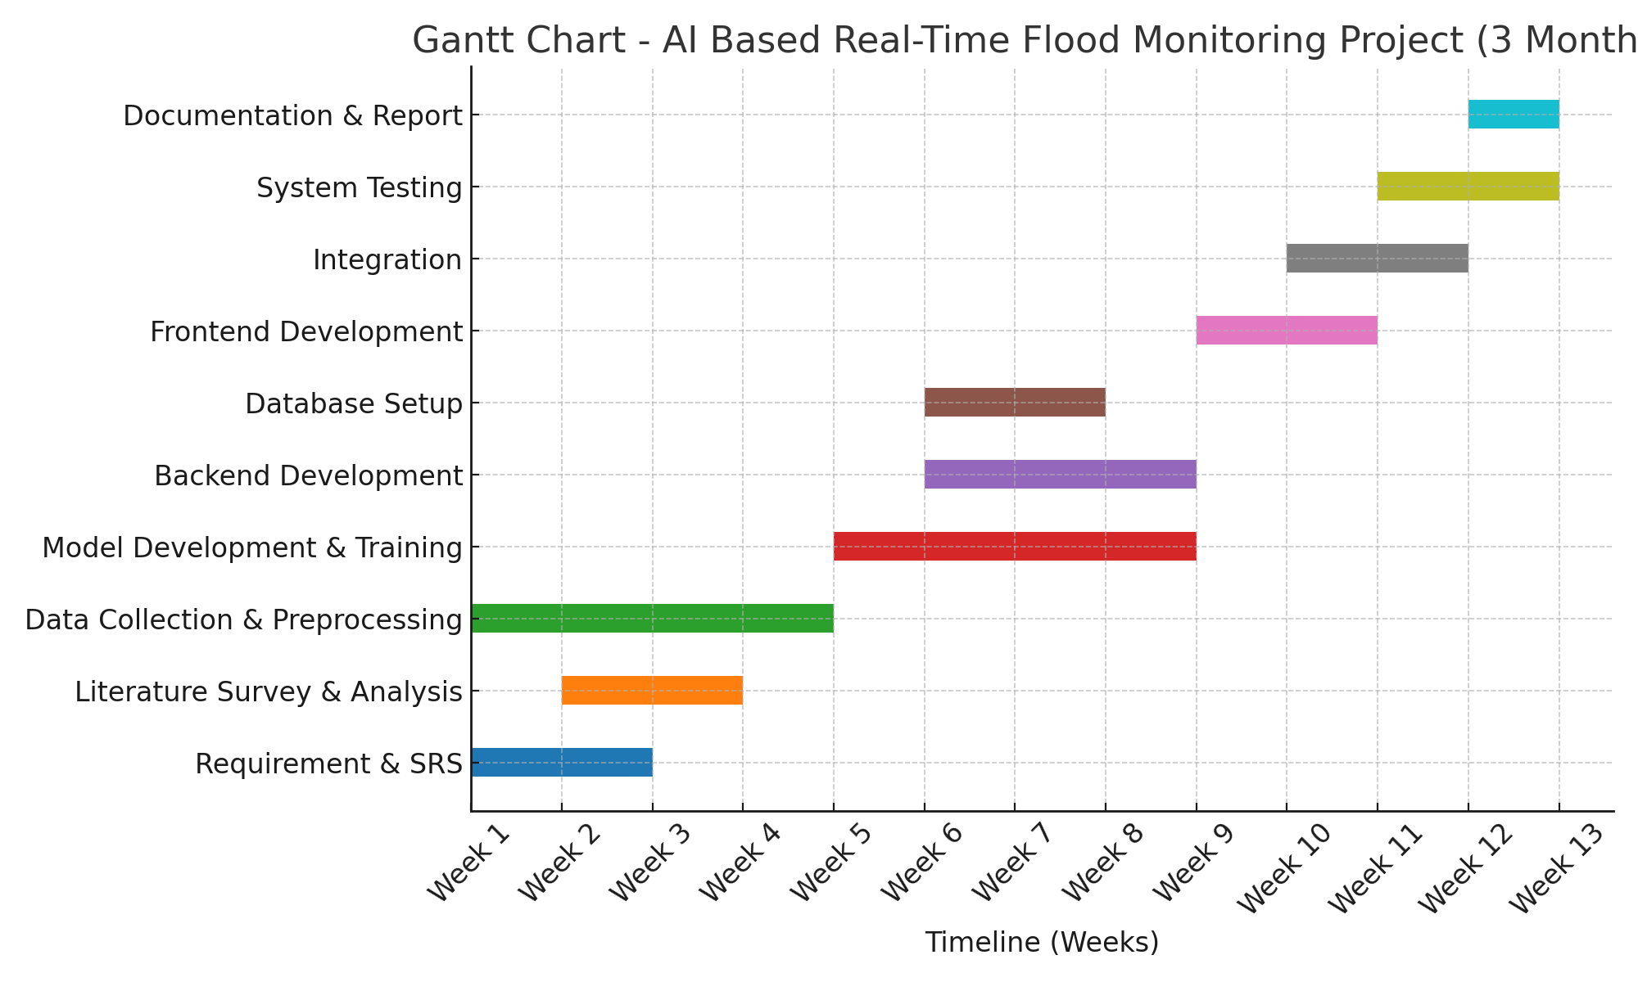
Timeline of the Project (Gantt Chart)

Slide 11
References (IEEE Paper format)
P. Ghorpade, A. Gadge, H. Chordiya, B. Hooli, A. Lende, G. Gosavi, Y. S. Ingle, A. Mishra, and N. Shaikh, “Flood Forecasting Using Machine Learning: A Review,” in Proc. 2021 8th International Conference on Smart Computing and Communications
S. Ramasamy, P. Ranjith Kumar, M. Vimala, N. Najmul Sahi, A. Rajesh, and S. Siddharth, “Flood Prediction Using Supervised Machine Learning Algorithms,” in Proc. 2024 5th International Conference on Smart Electronics and Communication
J. Gupta, “AI-Enhanced Flood Warning Systems with IoT Sensors in Urban Zones,” International Journal for Research in Applied Science and Engineering Technology, vol. 6, no. (issue), pp. 73561–73571, 2018, doi: 10.14569/IJACSA.2018.091187. (Published via IEEE Access)

Slide 12


